Slide 1
How to use this slide template
The PowerPoint should be used as a baseline template for parent workshops.
It is expected that you will add additional local information.
All text that should be edited or added to is highlighted yellow and/or red.
Add any additional information should be added to existing slides, or by creating new slides, as appropriate.

Slide 2



The Potty
Training Guide
A useful guide to help your child transition from nappies to confident, independent toileting.
pottytrainingguide.co.uk

Slide 3
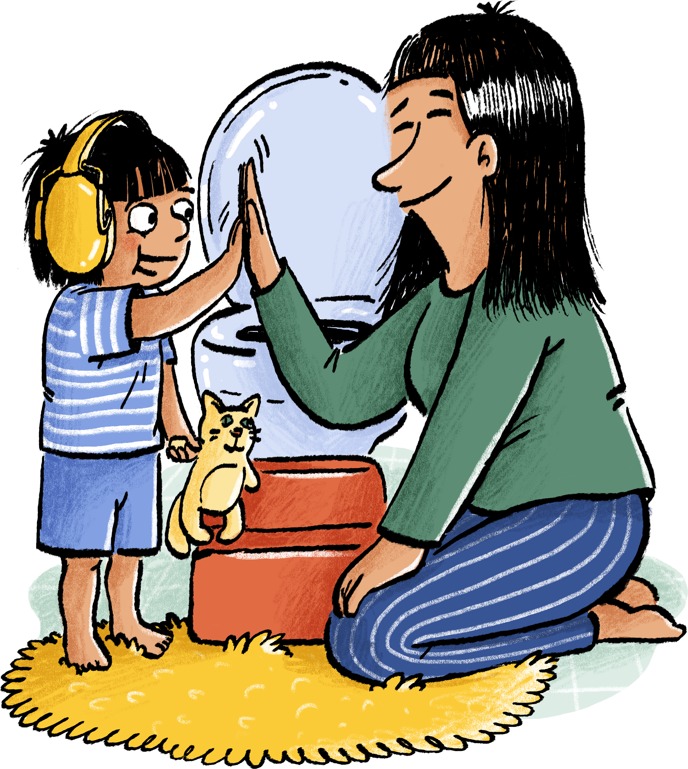
Outcomes
To provide you with the confidence and skills to support your children to be potty trained.
To understand potty training is a process and not a single event. It happens over time.
Potty training is an important milestone in your child’s development.

Slide 4
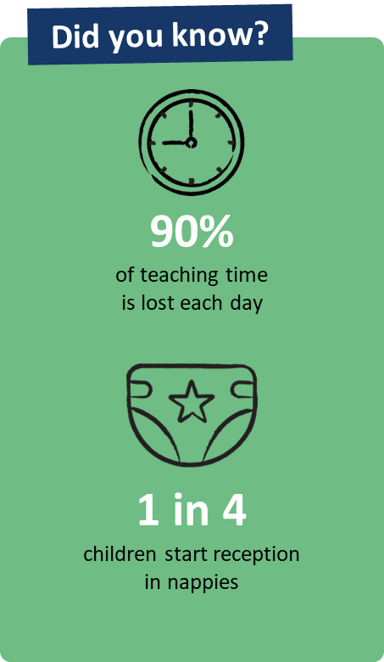
Why Potty Training Matters
Research shows it’s best for your child’s bowel and bladder health to stop using nappies between 18-30 months.
Being out of nappies helps children feel confident, healthy and part of the group. It also means teachers can spend more time teaching and supporting development in other ways.
2.5 hours of teaching time is lost every day and
affects every child.

Slide 5
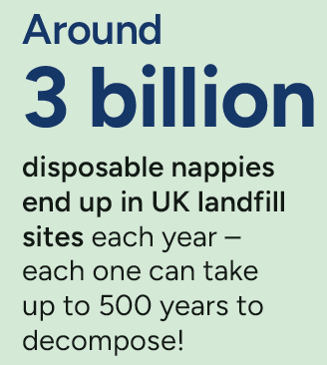
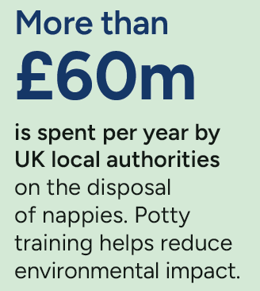
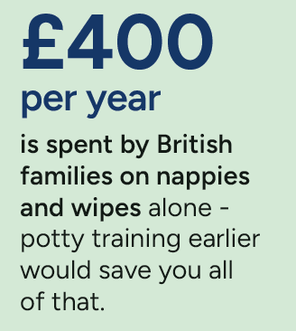
The impact of potty training

Slide 6
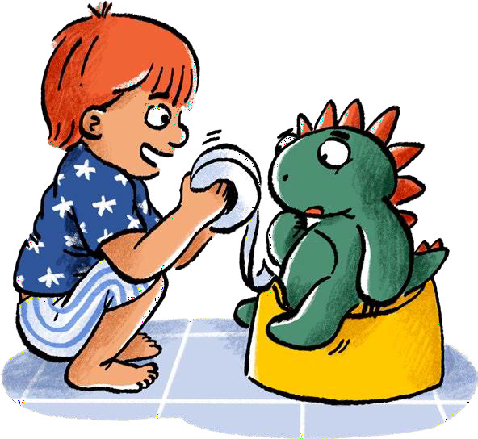
How do I know when to start?
Almost all children can learn to be clean and dry with the right support including children with special educational needs and disabilities (SEND). Children with special needs may take a little longer and need more support. However, the process you need to follow is the same. Remember – adapt not avoid!
The only exception should be children with a diagnosed medical need, such as a bladder or bowel condition.
Children can practice sitting on a potty or toilet from when they can sit up independently. The longer you wait, the harder it can be for your child to learn the new routine and feel confident without nappies.

Slide 7
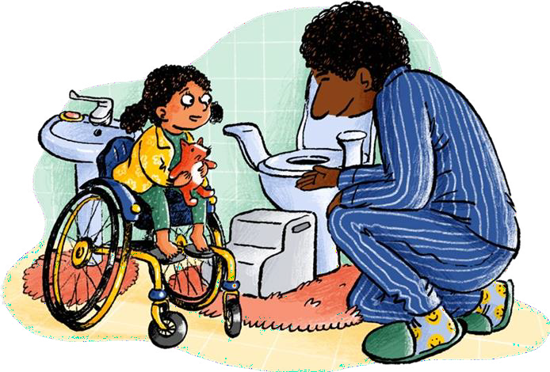
Learning new skills
Toilet Training is about learning skills which can be taught with extra help and a clear routine.
There are 40 different skills to learn and put together to become toilet trained.
It is important to remember that toilet training is a process and happens over time, so don’t “wait until your child says they are ready” as some children will never say or appear to be ready.

Slide 8
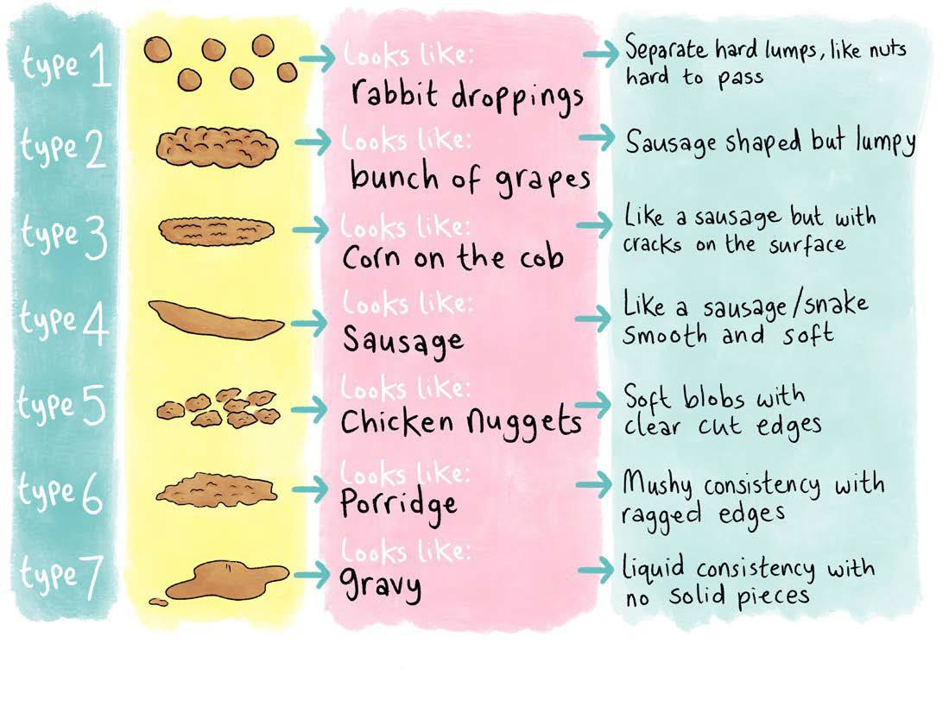
Healthy Poos
Before commencing, make sure your child is not constipated – they should be doing a soft poo regularly (at least every other day). If you think your child might be constipated, it is important to get help with this before stopping nappies.
The ideal poo should look like type 3 or 4 on the Bristol Stool Chart.
1 in 3 children suffer with constipation
Bristol Stool Chart

Slide 9
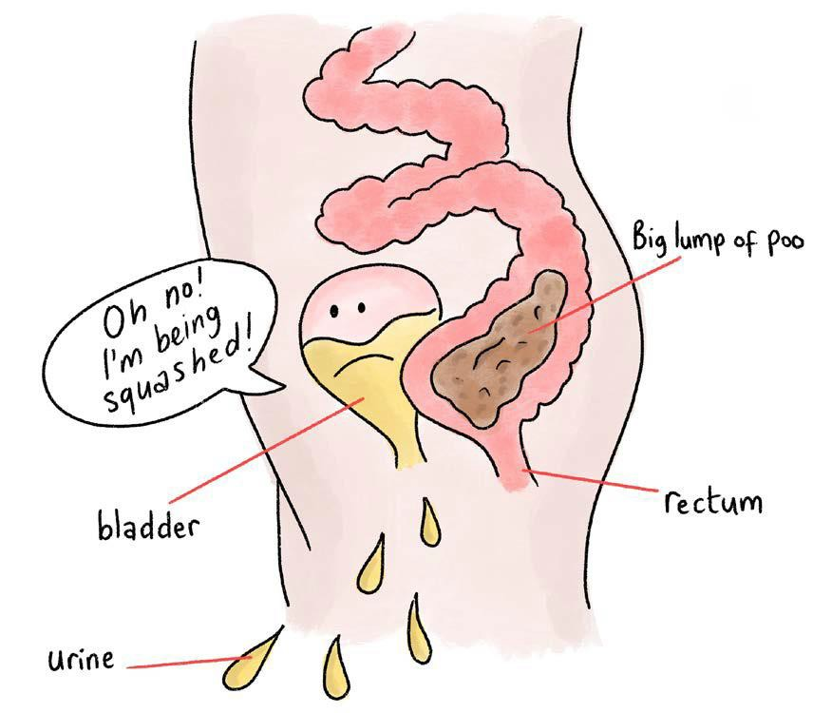
“Poo Squishes Wee!”
If a child is constipated, they can lose the sensation to poo.
The bowel stretches and becomes a big store of solid poo which can then squish the bladder and children can have wee accidents.

Slide 10
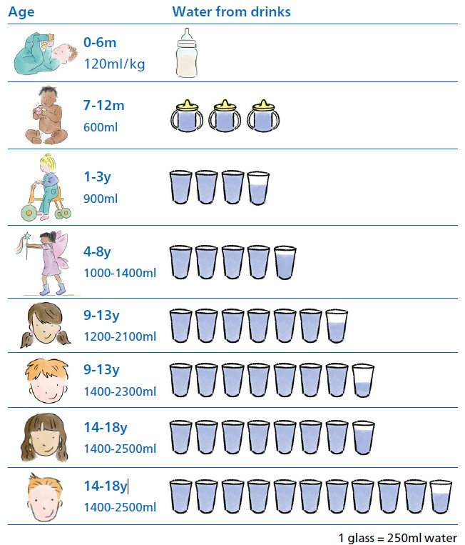
Healthy Wees
To ensure healthy wees and poos, children should be having 6-8 water based drinks spaced out during the day.
This helps the bladder to stretch and can hold more wee. The bladder is a muscle which needs to be worked!

Slide 11
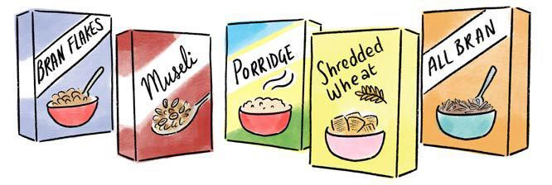
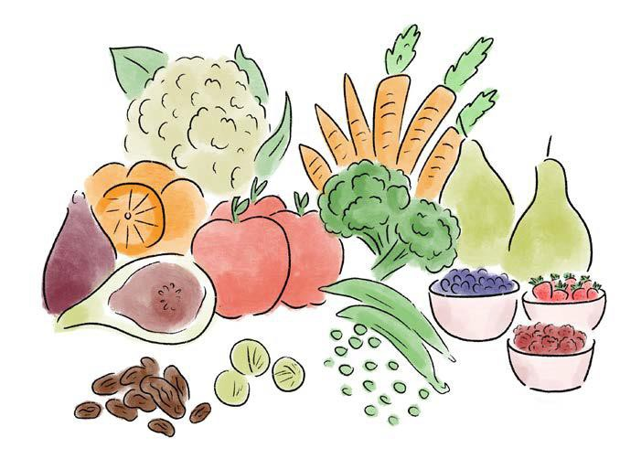
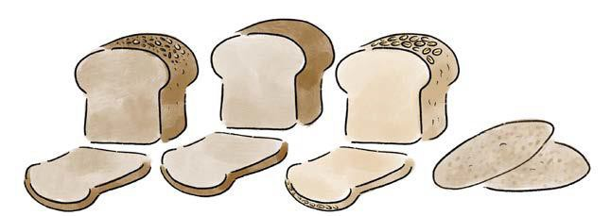
Balanced Diet
Look at your child’s diet, they should be eating a balanced diet with lots of fruit, vegetables and foods high in fibre such as wholemeal pasta, bread and cereals.
Fibre helps muscles to work properly in the bowel by helping move poo through the body. Fibre adds bulk and helps soften poo by holding water. This can help prevent constipation.

Slide 12
Potty training is a learning process
Learning how to use the potty independently and stopping wearing nappies is a big milestone for you and your child. There are lots of new and exciting skills for them to learn with your help.
Think of the learning process as a 3-step approach.
It begins with preparation to use the potty or toilet, next is practicing toileting skills before eventually stopping using nappies as your child gains confidence.
Start teaching your child to use a potty or toilet before they stop using nappies. This gives them all the time and practice they need to succeed with being independent from nappies when the time comes.

Slide 13
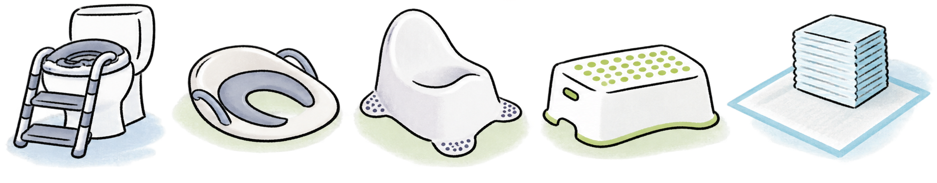
Equipment Needed

Slide 14
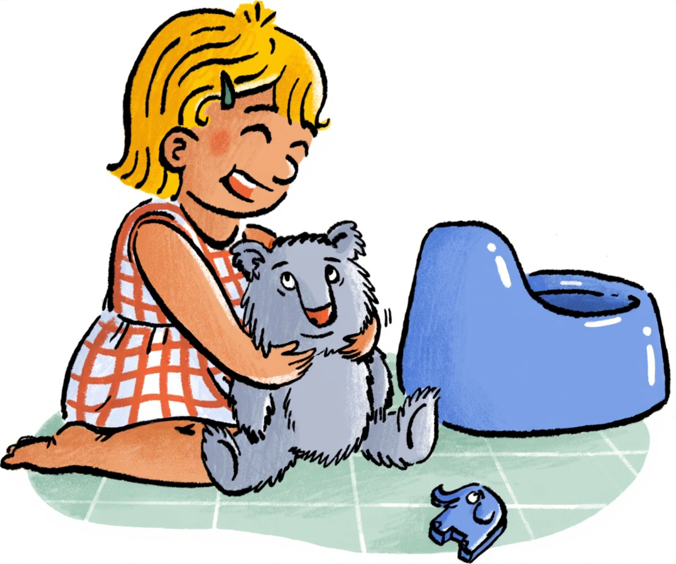
Getting Ready:
Change
Introduce
Sit
Change nappies as soon as they are wet or soiled. This teaches your child to be clean and dry.
Introduce your child to a potty or the toilet. Read some books about potty training and help their favourite toy to have a “turn”.
Have regular potty or toilet sitting practice. Build up to several times a day once they've been introduced to the potty or toilet.

Slide 15
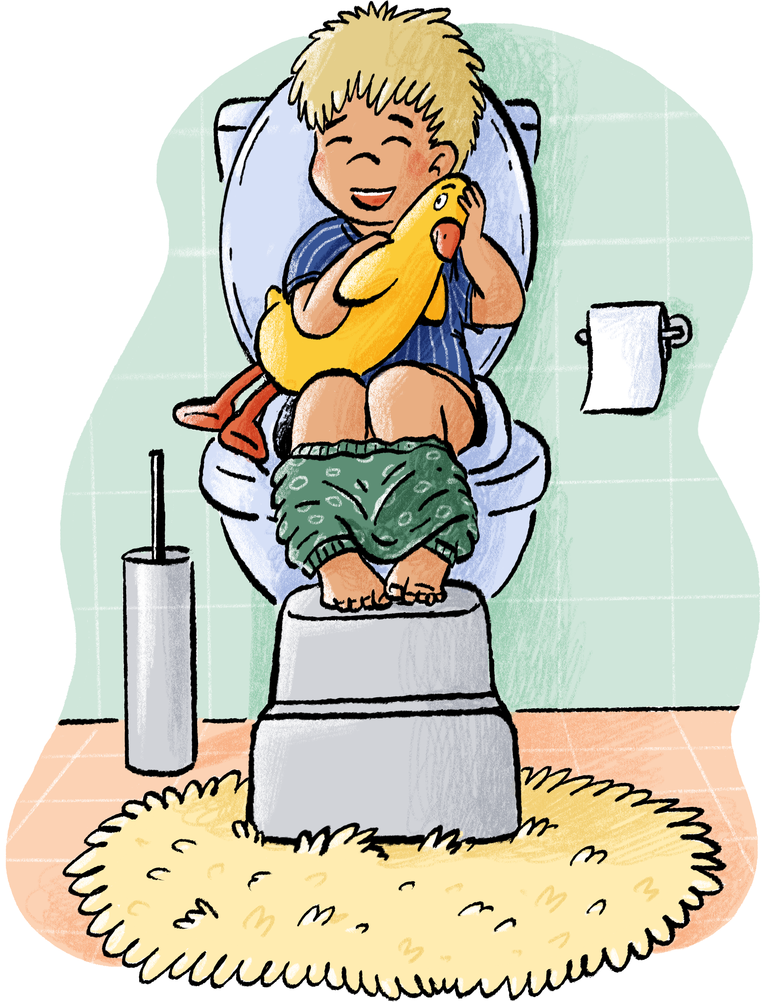
Top Tips!
Change nappies standing up on the floor (once your child can stand) in the bathroom and involve them in pulling trousers up and down, flushing poo, washing hands.
Give regular nappy free time. Try this after they have done a wee or poo so they learn how it feels to be nappy free. Help them put a nappy back on after 30 minutes.
Talk about wee and poo in a matter of fact way and avoid using words such as “stinky” and “smelly.”

Slide 16
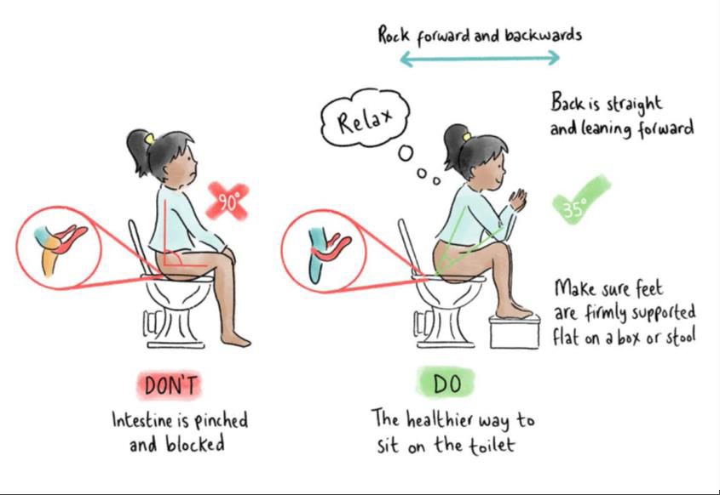
Correct sitting Position:
It is important your child feels safe and comfortable when using the toilet.
Use a foot stool that is high enough that your child’s knees are slightly above their hips. This correct sitting position helps to relax the muscles and ensures the bowel isn’t kinked to allow easy passage of stools.
Sitting on the potty also creates the same position.

Slide 17
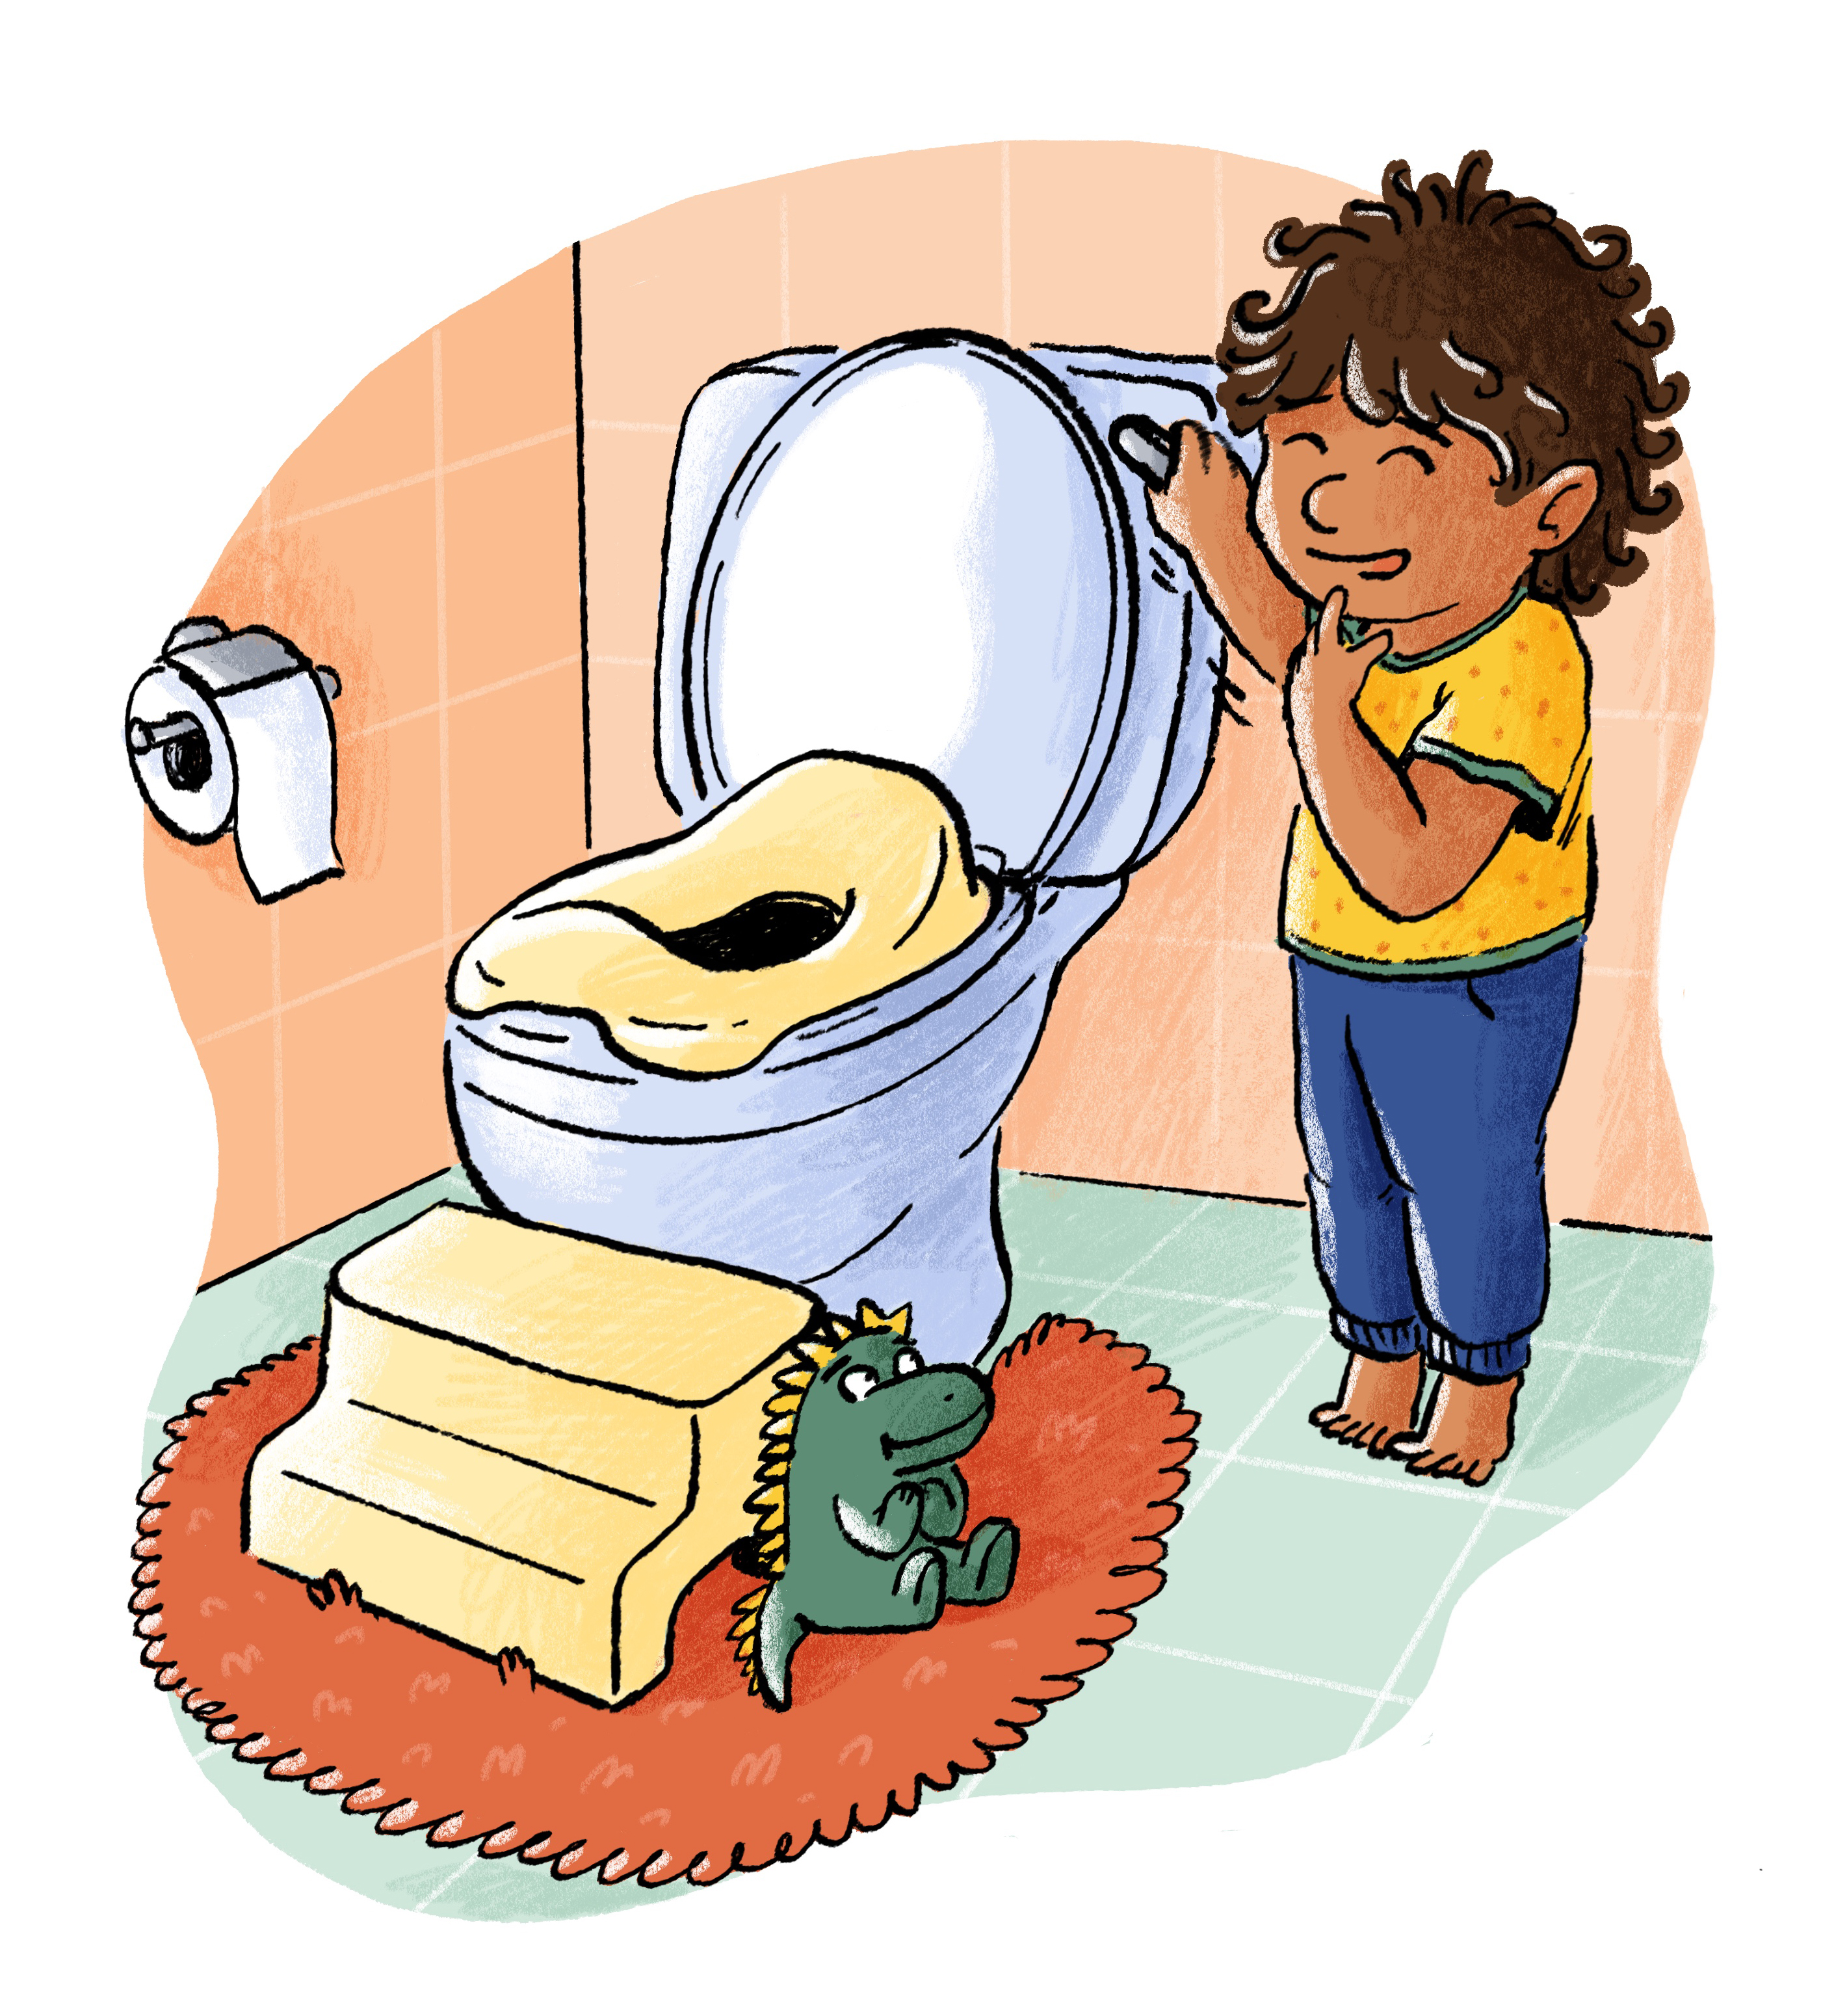
Keep Practicing
During the practice stage, you are supporting your child to feel comfortable sitting on the potty or toilet and gives them confidence that sitting on the toilet is a normal part of life.
It is important to remember that during the practice stage, your child will still be wearing nappies but will boost their capabilities and awareness if they are having nappy free time and regular sits on the toilet.

Slide 18
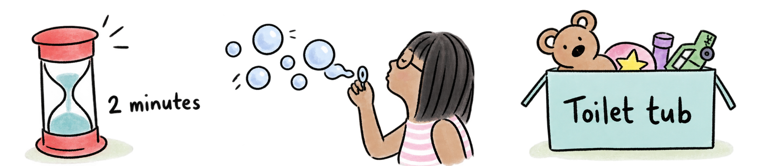
Top Tips when Practicing
If you find your child is a little resistant to sitting on the toilet or hops on and off quickly, think about ways to distract them.
Use books as a distraction or have a toileting tub or drawstring bag which has wipeable toys such as a favourite toy, fidget spinner, bubbles or a sand timer.
Using role play can help teach your child what to expect as well as motivate them. You can use stories, characters and toys to explain to your child what they need to do.

Slide 19
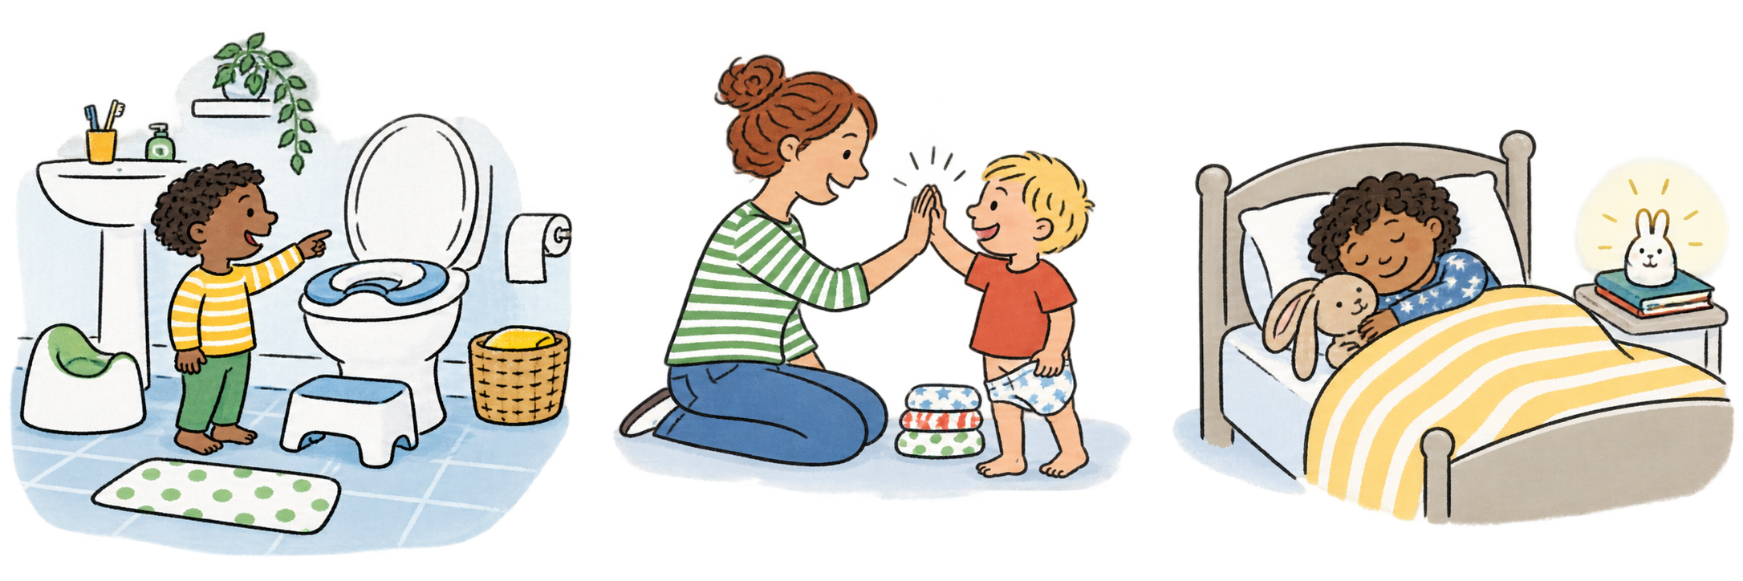
Think about the bathroom environment
Ensure the bathroom is warm and inviting!
Close the windows and maybe put up some posters for your child to look at.
Ensure the toilet is comfortable to sit on.
Some children fear they will fall into the toilet, so it is
important to get an add-on seat for smaller children.
Bright lights in the bathroom can be off putting for some children.
Think about bathroom smells – is the air freshener too strong? Is there a lingering smell from the person before?

Slide 20
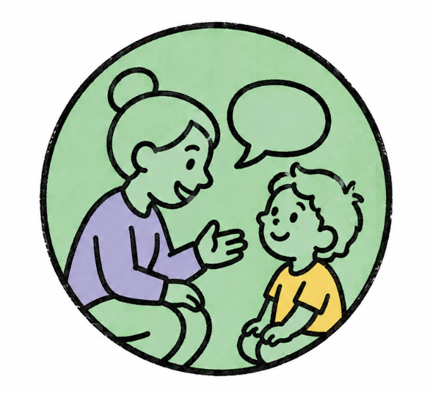
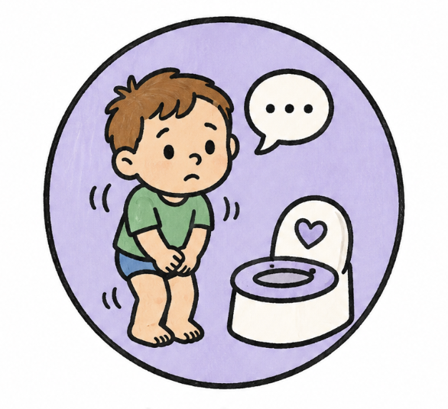
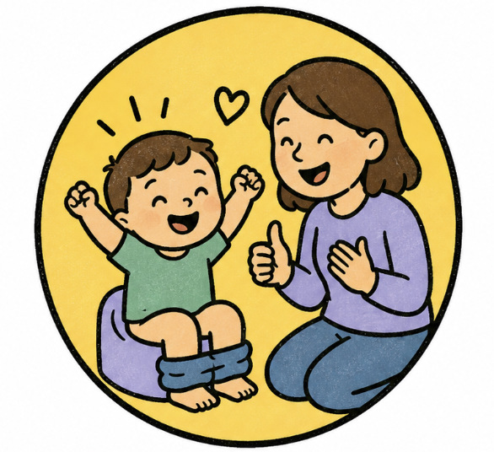
Stopping Nappies – The Process
Choose a time that works for your family, when life is relatively calm without major changes or disruptions.
Tell your child.
Explain they’re saying goodbye to nappies during the day and what using the potty or toilet means.
Watch for signs.
Fidgeting, going quiet, straining, or telling you they need to go. Guide them to the potty or toilet when you see signs.
Praise and encourage.
Celebrate every attempt and success. Praise sitting on the potty or toilet - any wee or poo is a bonus!

Slide 21
Top Tips when Stopping Nappies
If you see any of the signs or you know your child needs to do a wee or poo, gently direct them to use the toilet by saying “It’s toilet time,” or “Let’s get that wee or poo in the toilet.”
Avoid asking too often! (A good time scale is 1.5-2 hours.)
Encourage boys to sit down. It helps them to feel more relaxed and if they need a poo, it will encourage them to go.

Slide 22


Building Skills and Consistency
Stay Consistent: Once your child starts using pants during the day, consistency helps them learn faster. Avoid reverting to nappies when going out—this can be confusing.
Handle accidents calmly: Clean up together, gently remind them about the potty or toilet, and move on. No fuss means less anxiety and more success next time.
Wiping
Flushing
Hand Washing
Choosing Pants
Wiping Flushing Handwashing Choosing
pants
Children should be able to wipe themselves by the time they start in Reception.

Slide 23
Nap Time Transition
Once your child is no longer using nappies during the day, it’s time to think about nap times.
Being nappy free at nap times will help prepare your child to be dry at night.
Encourage children to use the potty or toilet just before their nap and when they wake up.
Stop using nappies once they are staying dry.
Use a puppy training pad on their bed or cot, just in case of any accidents.

Slide 24
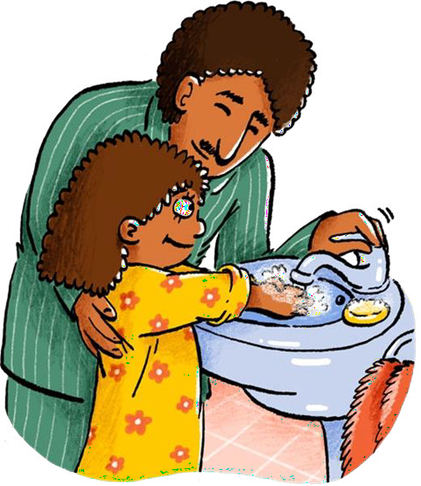
Night Time Success
Being dry over night usually happens after children are toilet trained during the day. Most children will be dry over night by the time they are 5, but some take longer.
Have a consistent bedtime routine.
Stop having drinks one hour before bed.
Encourage your child to go to the toilet before bed, even if they are wearing a nappy.
Avoid waking or “lifting” to take them to the toilet in the night as
this encourages them to wee in their sleep.
If your child isn’t dry by the age of 5, speak to your Health Visitor, School Nurse or Health Care Professional.

Slide 25



Team Effort. Working Together.
If your child is at nursery, pre-school, with a childminder or regularly looked after by others, talk to them about supporting your child's potty training journey so you all start at the same time.
Agree on steps you'll all take and provide plenty of spare clothes, footwear and bags for wet or dirty clothes.
This consistency helps your child learn faster.
It is important that you have clear lines of communication during this time so having a home/school book to share concerns and successes is vital.

Slide 26
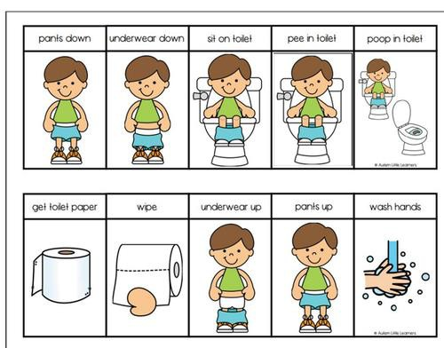
Supporting Communication Needs
If your child needs help communicating, teach words and signs for toilet, wee and poo and use pictures to help your child recognise it is time to use the potty or toilet.
Visual schedules are a great way of supporting children to become independent using the potty or toilet.
Sequencing multiple steps of an activity can be a challenge for children with communication difficulties, therefore visual schedules help to display these in a clear way.

Slide 27
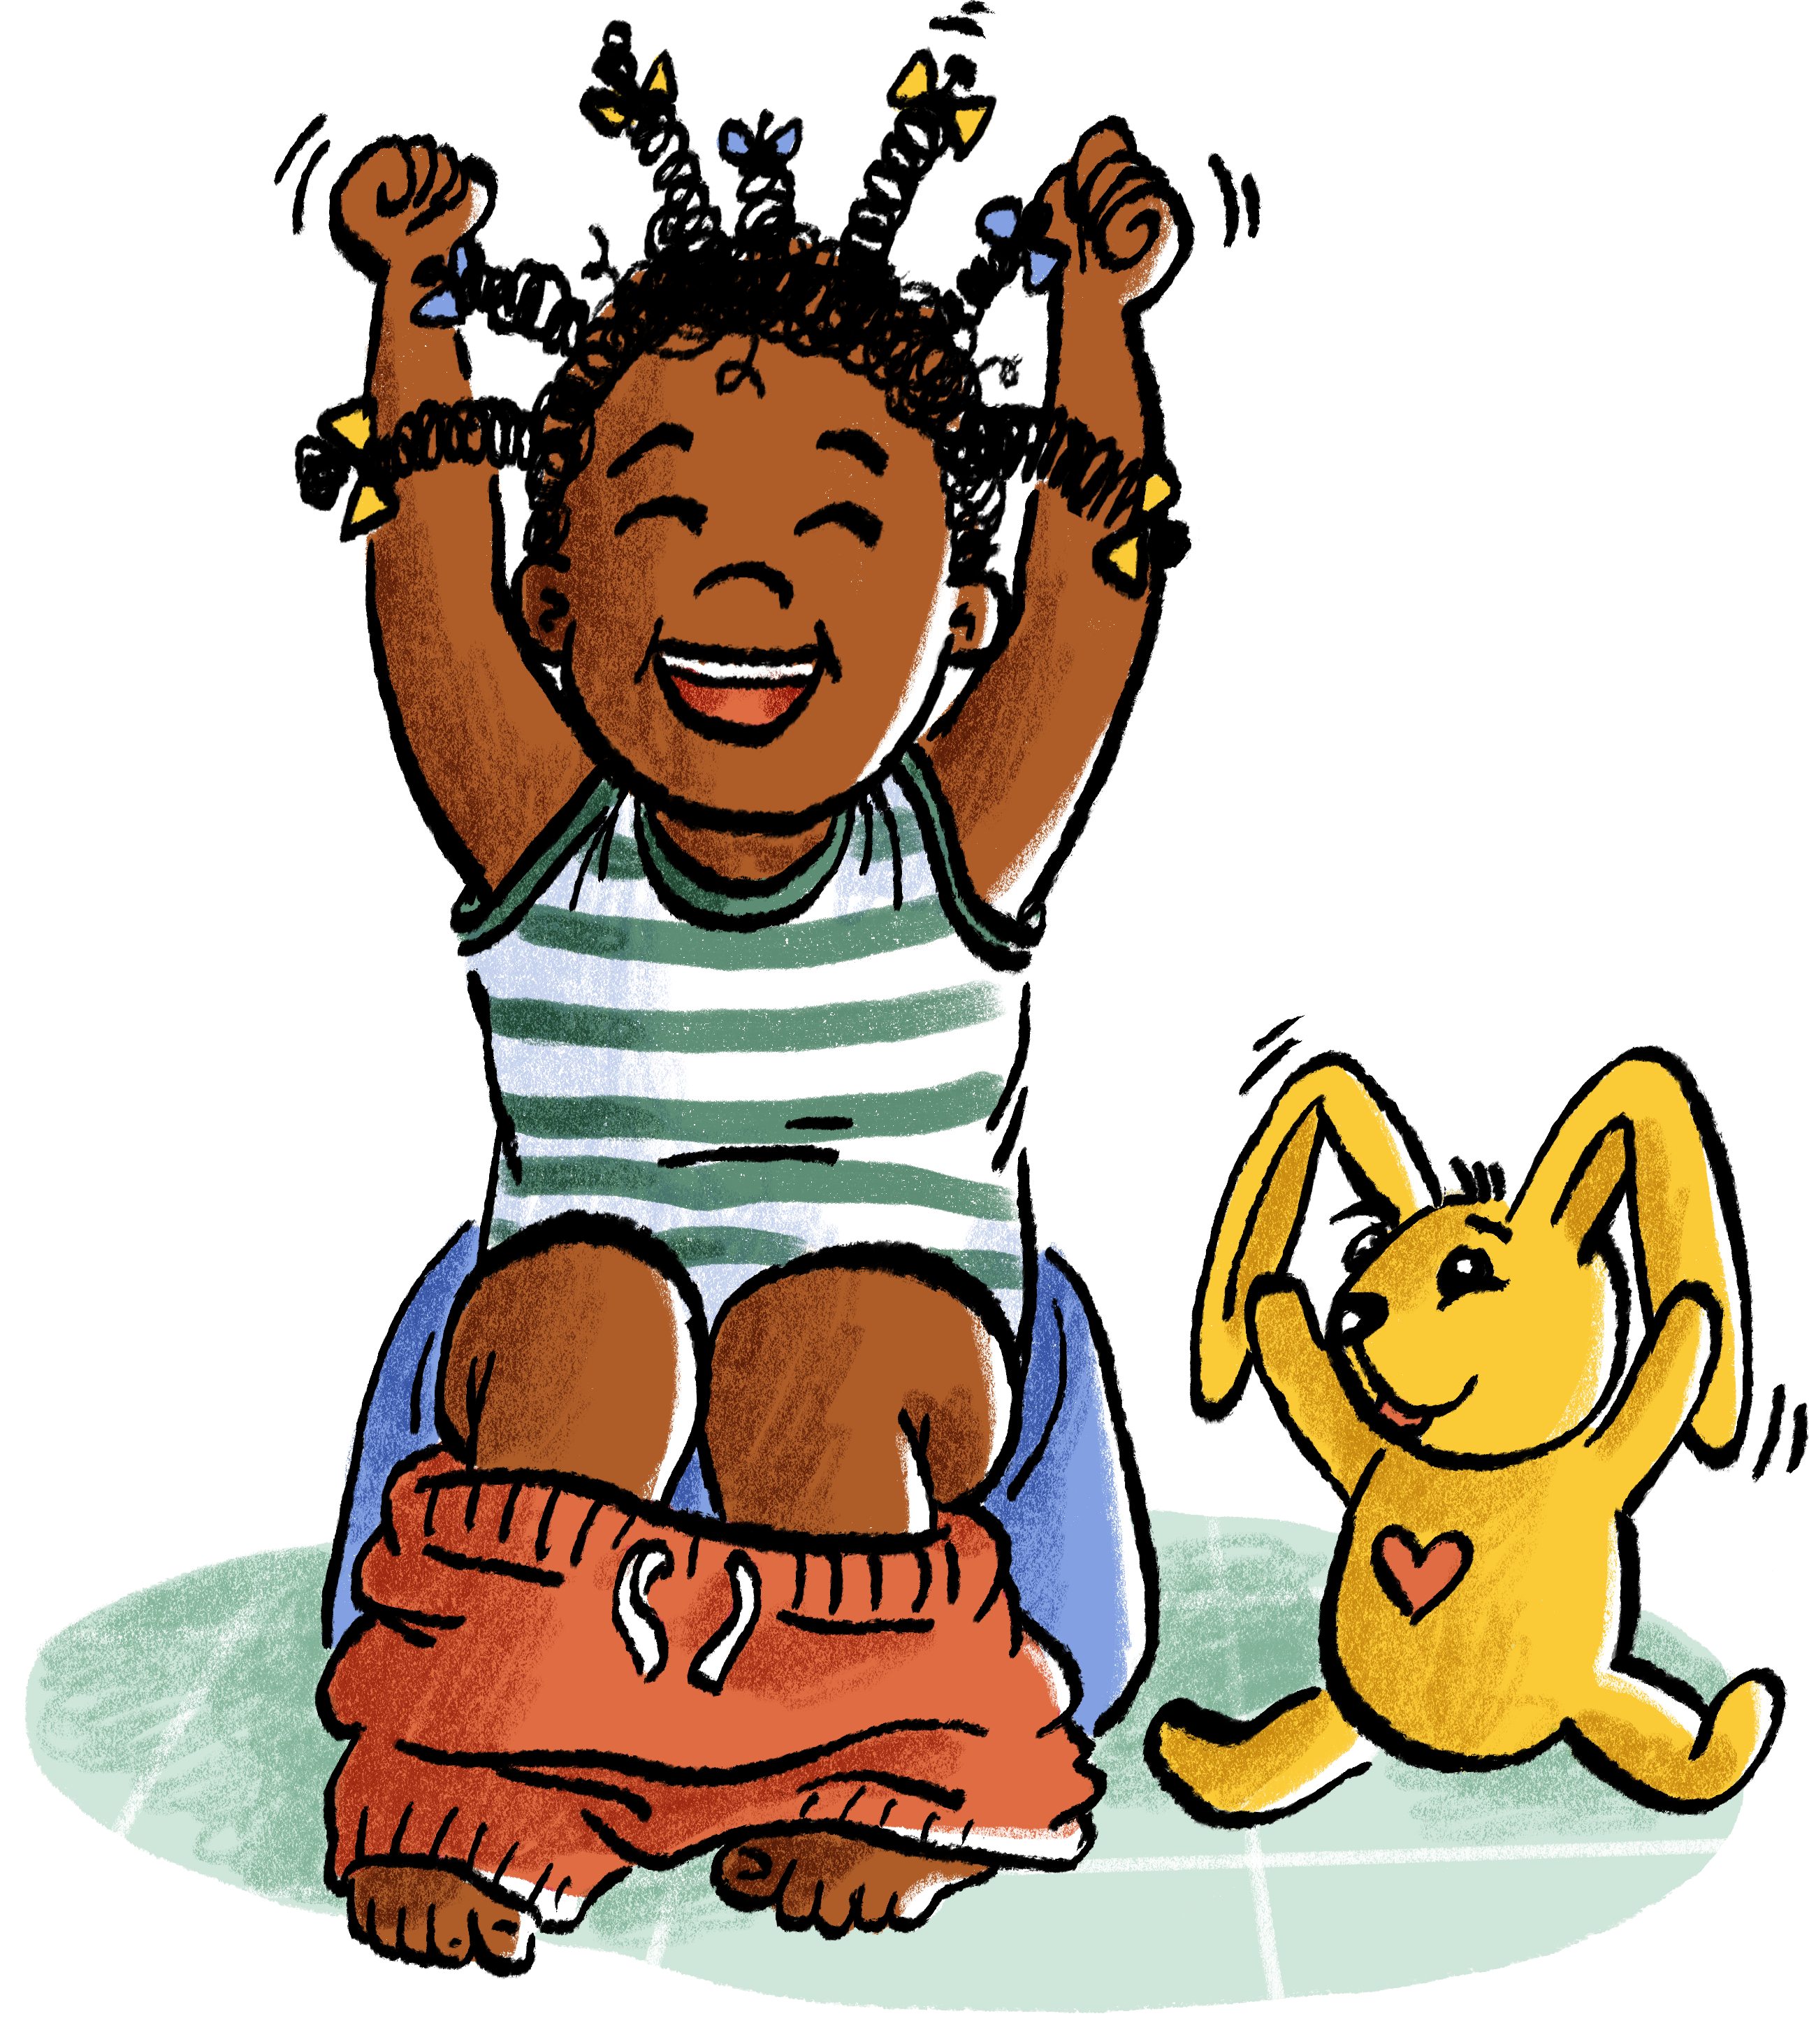
Keep Going!
You might find along the way, that some days are harder than others and there are lots of accidents.
Don’t give up and try not to put your child back in nappies during the day.
Remain calm, give encouragement and try again tomorrow.
Give your child the opportunity to do things for themselves as much as possible. This will help them to feel in control, positive and relaxed about the process.
Sometimes it feels like your child has gone backwards with toileting, this can be normal. Remember, your child is still learning how to put all the skills of toilet training together.
There is lots of support available to help and you can ask during any conversations with your health visiting team.

Slide 28
Where to go for further help:
If you encounter problems along the way, support is available:
ADD LOCAL SUPPORT SERVICE DETAIL

Slide 29


















The Potty Training Guide was created collaboratively by

