Slide 1



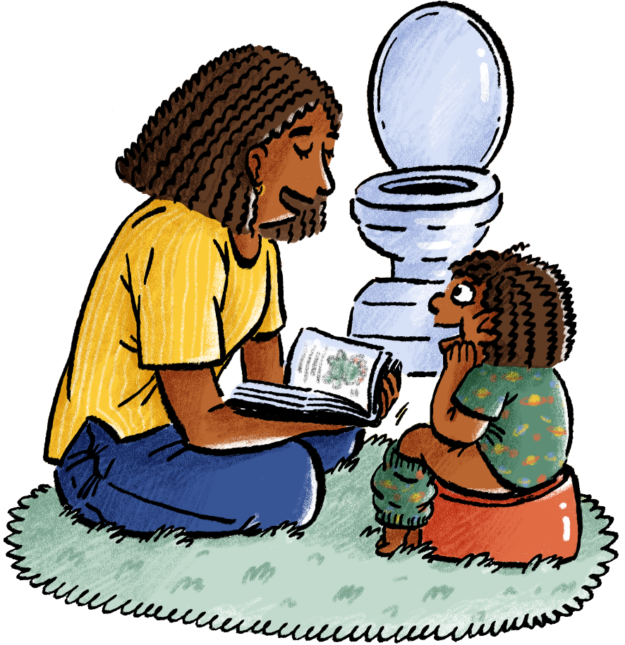
New Potty training guide
Launched
today
Backed by Government,
it’s free for parents,
carers, schools and
early years settings.
ADD YOUR LOGO HERE

Slide 2


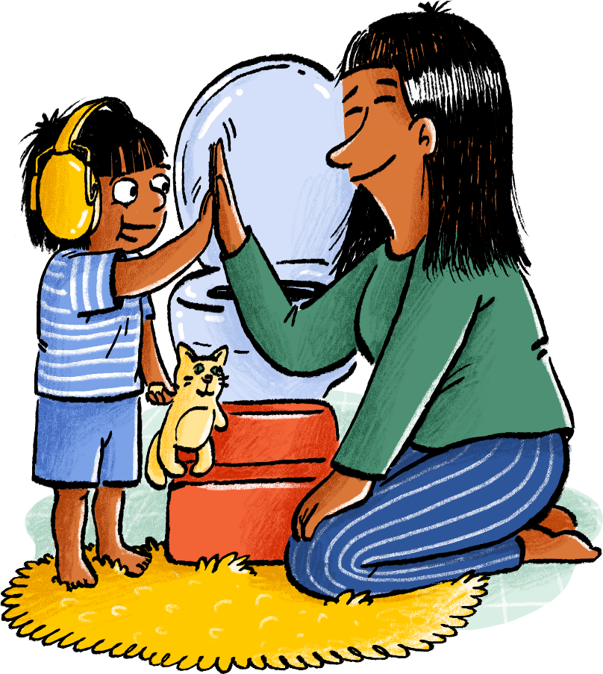

New Potty training guide
Launched
today
Backed by Government,
it’s free for parents,
carers, schools and
early years settings.
ADD YOUR LOGO HERE

Slide 3
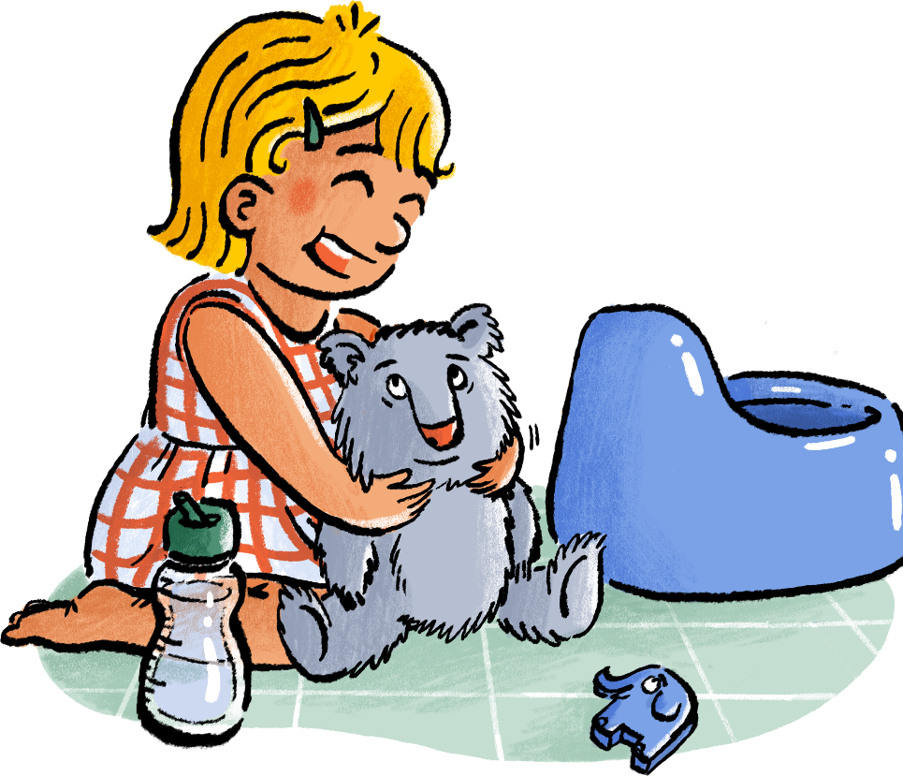
Help children start school with the confidence they need
Launched
today
ADD YOUR LOGO HERE

Slide 4
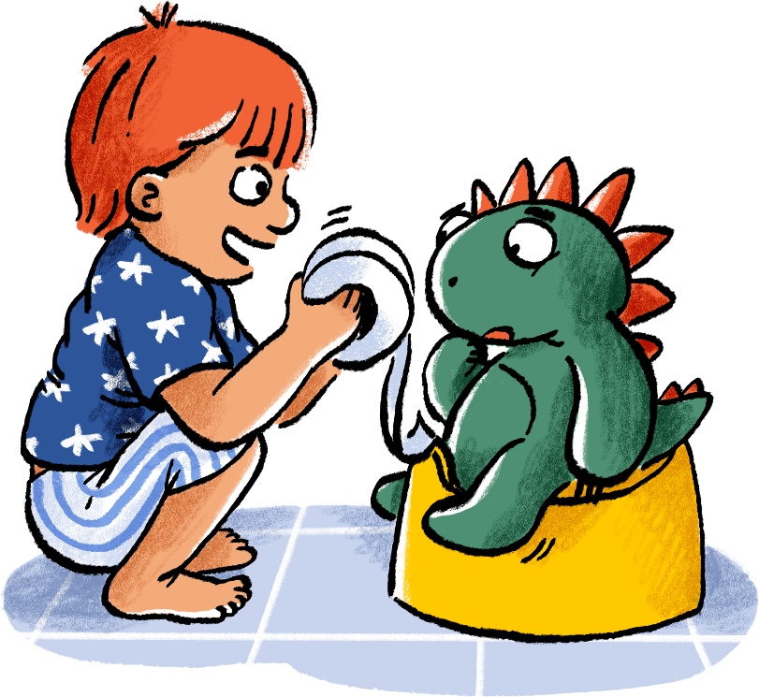
Help children start school with the confidence they need
Launched
today
ADD YOUR LOGO HERE

Slide 5


Help children start school with the confidence they need
Launched
today
ADD YOUR LOGO HERE

Slide 6
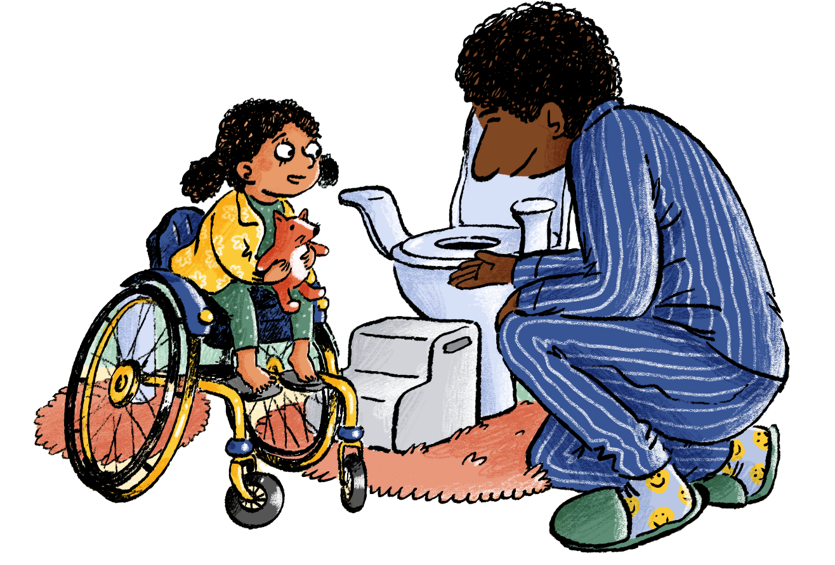
Help children start school with the confidence they need
Launched
today

